Slide 1
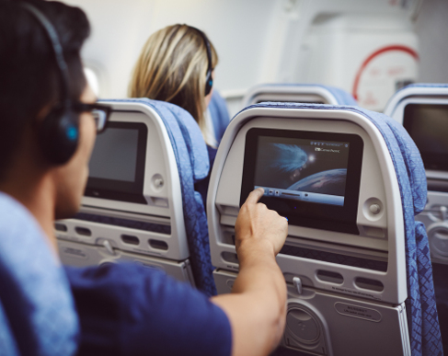
Inflight Planner
Plan your in-flight experience ahead

Slide 2

What happened?
Customer complaints
Often missed the meal
Wasted a lot of time
in searching entertainment
- Uncertain baggage delivery
Notes:
Live well travelled experience is one of the core values that Cathay Pacific wishes to bring to every single customer. Stepping…. It’s high time we consider how Cathay can take a step further to provide better service. We studied customer complaints and they complained that they often missed the meal because they felt asleep. They also wasted a lot of time in searching the suitable entertainment. Having said that, we came up with a solution of Flight Planner which is believed to address the problems.

Slide 3
Demo

Slide 4
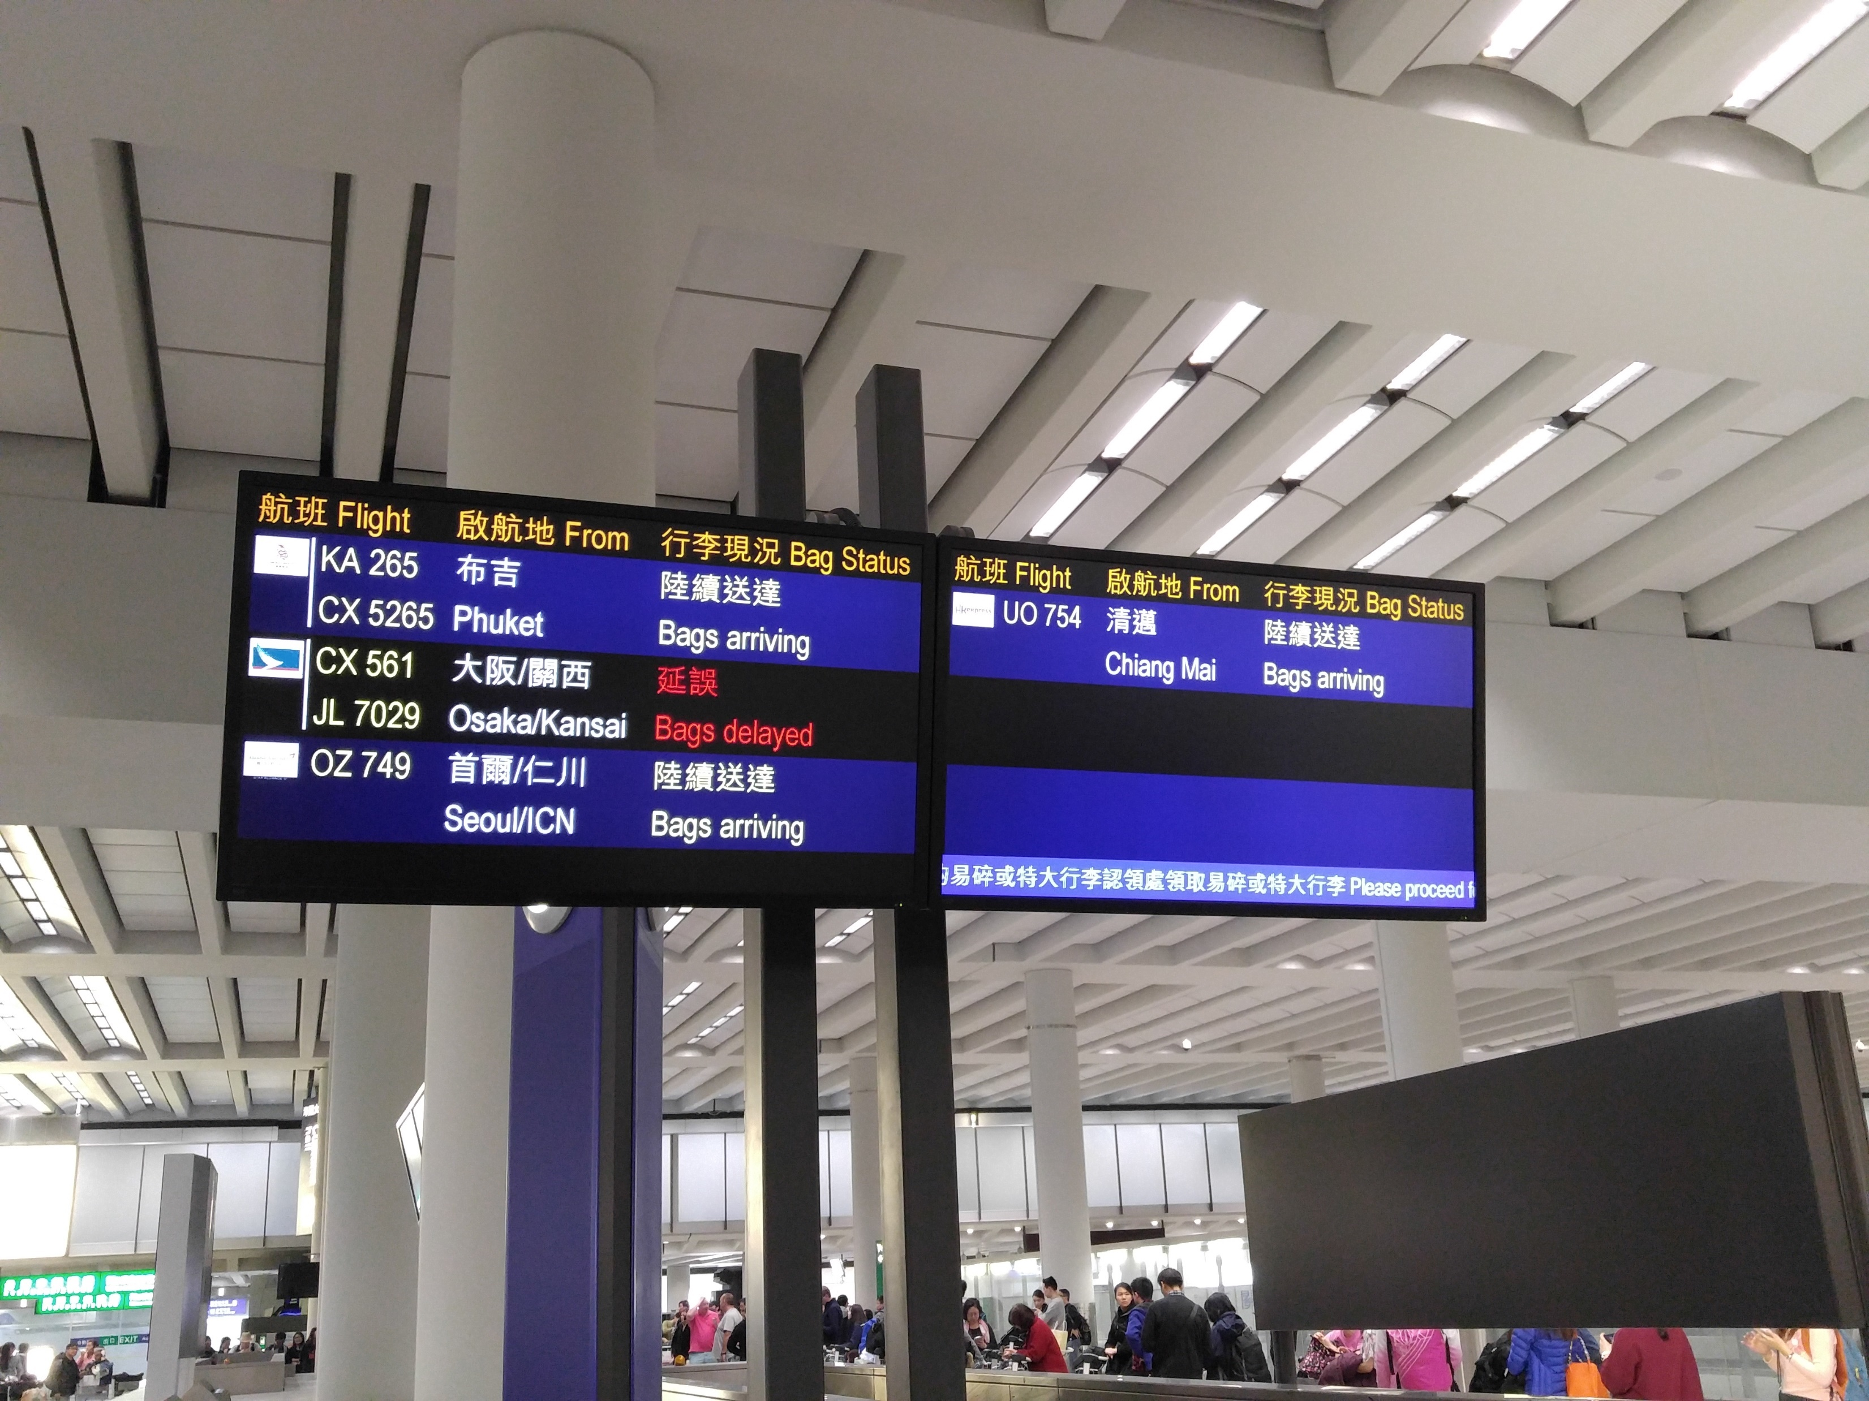
Big Data
With high volume and velocity of data,
The app can provide:
- Estimated Baggage Collection Time
- Personalized Recommendation

Slide 5
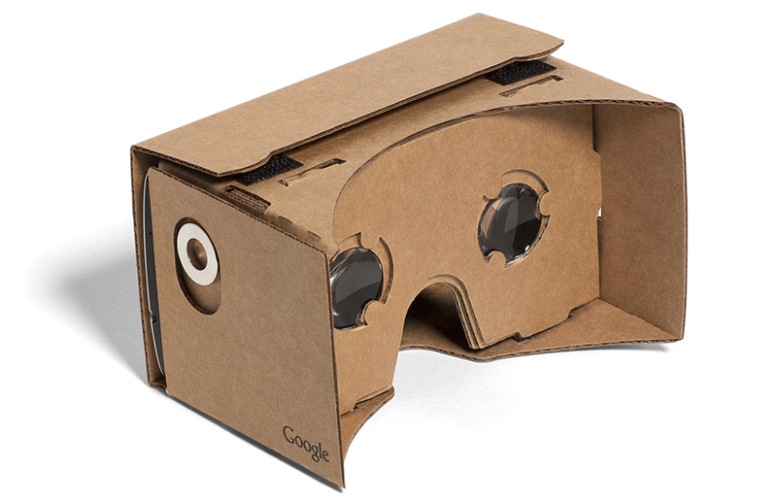
Virtual Reality
Enjoy VR content through the app & VR device provided by crew

Slide 6

Expected Impact
Short haul flights Passengers:
- Save time for searching
through the entertainments
Long haul flights Passengers:
- Better time management
-> avoid affecting the biological clock
Transparency of the schedules
Enhance travel experience
beyond the flights

Slide 7
Thank you!

